Slide 1

What’s important this week

Slide 2
Top Performers
August month-to-date production - New Orleans General Office
First Year Commission
Applied Cases
Paid Cases
1
Cabirac, James
1
Crouch, Casey
1
Henly, Christopher
Class 1P - $34,126 FYC
Class 1P - 13.00 applied
Class CC - 4.50 paid
2
Batiste-Webber, Buena
2
Trepagnier, Harrison
2
Cabirac, James
Class CC - $17,228 FYC
Class 2P - 4.59 applied
Class 1P - 3.00 paid
3
Shelton, Clifford
3
Malone, Brooks
3
Capasso, Michael
Class 1P - $12,740 FYC
Class 1P - 4.50 applied
Class 3P - 3.00 paid
4
Savage, Zachary
4
Johnson, Chamon
4
Schulman, Jordan
Class CC - $8,067 FYC
Class 1P - 4.00 applied
Class 1P - 2.00 paid
5
Crouch, Casey
5
Ballard, William
5
Woodrick, Jeanne
Class 1P - $3,868 FYC
Class 2P - 4.00 applied
Class 2P - 2.00 paid
6
Woodrick, Jeanne
6
Savage, Zachary
Class 2P - 4.00 applied
Class CC - 2.00 paid
Concrete wins. Keep the momentum going.
Notes:
Open the meeting with recognition. These are August month-to-date numbers for the New Orleans General Office, pulled from the current MTD recognition report.
Three ways to show up on this board: first year commission (FYC), applied cases, and paid cases. Call out that the lists are different people - Lawrence Cabirac leads FYC and also appears on paid cases; Casey Crouch leads applied cases by a wide margin at 13. That is the point: there is more than one path onto this slide.
Read every name out loud. Ask the two or three at the top what changed in their week - the answer is almost always activity, not luck.
Presenter note: if the office wants to honor someone not captured in the production report, duplicate this slide before the meeting and add them.

Slide 3
Market Week Overview
Week ended Friday, August 14, 2026
Week Ahead: August 17 - August 21, 2026
Notes:
Set the frame. Stocks ground out a third straight weekly gain, but underneath the surface the story changed: soft inflation data cooled September rate-hike fears, while a sharp drop in retail sales and a slump in consumer sentiment raised questions about the consumer.
The week ahead is data-light on the macro side but heavy on retail earnings - Home Depot, Lowe's, Target, TJX and Walmart all report. Wednesday's FOMC minutes are the single most-watched item.
Tell the room this section takes about ten minutes and the last slide is the one they can use with clients today.

Slide 4
Week in Review: U.S. Markets Overview
Third straight weekly gain for the S&P 500, led by small caps.
S&P 500 closed at 7,785.76 on Friday, up 0.4% for the week - a third consecutive weekly gain after setting a record above 7,800 midweek.
Nasdaq Composite added 0.1% to 26,729.16, also a third straight weekly gain, supported by continued AI infrastructure spending.
Dow Jones Industrial Average fell 0.6% to 53,732.41, snapping a two-week winning streak on weakness in healthcare and traditional industrials.
Russell 2000 surged 3.15% to a record 3,068.42, sharply outperforming large caps as domestically focused small caps led.
10-year Treasury yield ended at 4.68%; the 2-year finished at 4.17%. The VIX closed near multi-month lows around 14.85.
Plain English
Markets kept climbing, and for once the gains were broad instead of just the biggest tech names. Low volatility is comfortable - it is also when discipline slips.
Internal use only. For agent use only. Not for use with the public.
ELEVATE
NEW ORG
Notes:
Lead with breadth. The headline index move was small (+0.4%), but the Russell 2000 gaining 3.15% to a record is the real signal - participation widened beyond mega-cap technology for the first time in weeks.
Explain the Dow's decline honestly: it is a price-weighted index concentrated in healthcare and industrials, both of which lagged. It is not a sign the rally broke.
Point at the VIX near 14.85. Low volatility is not the same as low risk. That is the natural bridge into planning conversations.

Slide 5
Key Economic Data Released Last Week
Inflation cooled. The consumer did not cooperate.
July CPI (Aug 12): +0.1% for the month, 3.4% year over year, down 0.1 point from June. Core CPI +0.2%, 2.5% annual - also down 0.1 point.
Energy fell 1.5% on the month but remains 14.7% above a year ago. Shelter and food each rose 0.1%; medical care +0.4% and airfares +2.2%.
July PPI (Aug 13): final demand unchanged on the month and 4.7% year over year, down from 5.5% in June and below the 4.9% forecast.
July retail sales (Aug 14): -0.6% to $763.6 billion, the steepest monthly drop in more than a year, though still +5.0% versus July 2025.
University of Michigan consumer sentiment fell roughly 8% to a preliminary 51 in early August, ending a two-month rising streak.
NYLIM view
New York Life Investment Management's Macro Pulse describes a market where resilience remains the story, but the path is narrowing - persistent inflation and elevated rates leave less margin for error.
Internal use only. For agent use only. Not for use with the public.
ELEVATE
NEW ORG
Notes:
Two data stories collided last week and they point opposite directions.
The inflation story improved. Both CPI and PPI came in softer than expected, and that is what pushed September rate-hike odds down and let stocks finish higher. Note that core CPI at 2.5% annual is meaningfully better than the 3.4% headline - energy is doing most of the damage, and energy is still 14.7% higher than a year ago.
The consumer story weakened. Retail sales fell 0.6%, the worst month in over a year, and sentiment dropped to 51. Some of the retail decline is a timing shift around Amazon Prime Day, so do not overstate it - but pair it with sentiment and it is worth watching.
NYLIM's framing is useful here: constructive, but a narrower path forward. Use that language. It is honest without being alarming.

Slide 6
Economic Reports Calendar: Week Ahead
August 17-21, 2026: housing data all week, Fed minutes Wednesday.
Date
Report
Detail
Why it matters
Mon 8/17
Empire State Manufacturing (Aug), NAHB Housing Index (Aug)
8:30 am and 10:00 am ET
First read on August factory and builder sentiment.
Tue 8/18
Housing starts, Building permits, Import prices (Jul)
8:30 am ET
Housing supply pipeline and imported inflation.
Tue 8/18
Industrial production, Capacity utilization, Pending home sales (Jul)
9:15 am and 10:00 am ET
Factory output and forward housing demand.
Wed 8/19
FOMC minutes, July 28-29 meeting
2:00 pm ET - the week's main event
How many members wanted a hike, and what triggers September.
Thu 8/20
Weekly jobless claims (wk ending 8/15), Philadelphia Fed Index (Aug)
8:30 am ET
Layoff pulse and regional manufacturing.
Fri 8/21
S&P Global Flash Manufacturing and Services PMI (Aug)
9:45 am ET
Freshest read on August growth momentum.
Internal use only. For agent use only. Not for use with the public.
ELEVATE
NEW ORG
Notes:
Walk this quickly - the week is data-light by design, which raises the weight of each item.
Monday and Tuesday are housing. Mortgage rates are still elevated and both Home Depot and Lowe's report this week, so housing starts and permits on Tuesday morning set the tone for those calls.
Wednesday at 2 pm is the item to circle. These are the minutes from the July 28-29 meeting where the Committee held the funds rate at 3.50%-3.75% in a split decision with three dissents in favor of a hike. BofA economists caution the minutes are somewhat stale given the soft data since, but the market wants to know how many other members were leaning toward a hike and what the bar is for September.
Friday's flash PMIs are the freshest August data anyone will have going into Jackson Hole the following week.

Slide 7
Earnings Calendar: Week Ahead
Retail week: the consumer gets graded from five different angles.
Date
Company
Consensus EPS
Revenue / prior
What to watch
Tue 8/18
Home Depot (HD) - before open
$4.73
$47.2B est., +4.2% y/y
Big-ticket demand with mortgage rates high.
Wed 8/19
Lowe's (LOW), Target (TGT), TJX
$4.23 / $2.32 / $1.19
TGT sales est. $26.1B, +3.6%
Discretionary vs. off-price share shift.
Wed 8/19
Analog Devices (ADI), Estee Lauder (EL)
$3.34 / $0.32
Semis and global beauty
Chip demand breadth; China consumer.
Thu 8/20
Walmart (WMT) - before open
$0.74 (+8.8% y/y)
$186.9B est., +6.3% y/y
The single best read on the U.S. consumer.
Thu 8/20
Deere (DE), Ross Stores (ROST)
$4.69 / $1.94
Ag equipment and off-price
Farm economy; trade-down behavior.
Fri 8/21
BJ's Wholesale (BJ)
$1.17
Warehouse club
Membership renewal and food inflation.
Internal use only. For agent use only. Not for use with the public.
ELEVATE
NEW ORG
Notes:
This is retail week, and it lands three trading days after the worst retail sales print in over a year. That contrast is the story.
Home Depot Tuesday and Lowe's Wednesday are the housing read. Oppenheimer's Brian Nagel is below consensus on Home Depot at $4.66 and warns against expecting green shoots in home improvement while mortgage rates stay high.
Walmart Thursday is the one that matters most. Jefferies expects an in-line quarter and flags improving e-commerce margins and advertising revenue as underappreciated. Walmart tells you whether households are trading down, and trading down usually shows up in Walmart's numbers before it shows up anywhere else.
One structural note worth mentioning: Reddit joins the S&P 500 this week. Index inclusion drives mechanical buying and is not a fundamental signal.

Slide 8
Fed, Rates & Macro Watch
A Fed that was leaning toward hiking just got softer data.
The FOMC held the federal funds rate at 3.50%-3.75% on July 29 in a split decision. Three officials dissented in favor of a rate hike.
The statement described activity expanding at a solid pace with strong productivity and capital investment, but called inflation elevated.
Softer July CPI, PPI and a weak jobs report have since pulled September rate-hike expectations back down.
Wednesday's minutes are the last scheduled Fed communication before Chair Warsh's Jackson Hole keynote on August 27-29.
No FOMC meeting until September 15-16. The 10-year at 4.68% and 2-year at 4.17% leave the curve modestly positive.
Advisor angle
The debate is whether the Fed hikes, not cuts. Clients hearing 'rates stay high' should hear opportunity in guaranteed products, not a reason to sit in cash indefinitely.
Internal use only. For agent use only. Not for use with the public.
ELEVATE
NEW ORG
Notes:
Make sure the room understands the direction of the debate, because it is the opposite of what most clients assume. The dissents at the July meeting were in favor of raising rates, not cutting. Inflation at 3.4% headline with a funds rate of 3.50%-3.75% leaves very little real cushion.
Soft data since July has taken the September hike largely off the table, but "off the table" is not the same as "cuts are coming."
The practical point for agents: an environment where rates stay higher for longer is a good environment to talk about guaranteed accumulation and guaranteed income. Do not sell fear about the Fed. Sell the value of certainty in a plan when the rate path is genuinely uncertain.
NYLIM's Global Market Strategy team published "Steeper Curves, Building Risks" - worth reading before client conversations this week.

Slide 9
Sector & Theme Spotlight
Leadership rotated. Small caps and financials joined the rally.
Three shifts worth explaining to clients this week.
Broadening rally
Sector rotation
Consumer question
Russell 2000 +3.15%
Financials, Health Care up
Retail sales -0.6%
Small caps hit a record and led every major index
Energy dropped from second to sixth in relative strength
Sentiment at 51 sets up a high-stakes retail earnings week
Talking point: a rally that widens out is generally healthier than one carried by a handful of names. It also means diversification is finally being rewarded again - which is exactly what a plan is built to capture.
Internal use only. For agent use only. Not for use with the public.
ELEVATE
NEW ORG
Notes:
This slide is the "why should I care" slide for clients who only see the S&P number.
Point one: for most of 2026 the rally was narrow and technology-led. Last week small caps led by a wide margin and set a record. Broader participation is a healthier market structure.
Point two: relative sector strength shifted - technology stayed first, financials moved to second, health care to third, industrials entered the top five, and energy fell from second to sixth as oil prices eased.
Point three: the consumer is the open question. Retail sales fell 0.6% and sentiment dropped to 51 right before five major retailers report. That is the tension to watch this week.
Close with the diversification line. It is the single most useful thing an agent can say about last week.

Slide 10
Client Talking Points: What This Means for You
Plain-English language for client conversations this week.
Markets had another good week. Stocks rose for the third week in a row, and smaller U.S. companies did especially well after lagging for most of the year.
Price increases slowed a little. Inflation came in at 3.4% over the past year, down slightly from June. That is progress, but prices are still rising faster than the Federal Reserve would like.
People shopped less last month. Retail spending fell 0.6% in July and confidence surveys dropped. One month is not a trend, but it is worth watching.
Interest rates are likely to stay where they are for now. The Fed is not signaling cuts. If anything, some officials wanted to raise rates in July.
What this means for you: nothing about last week changes a well-built plan. Higher-for-longer rates can actually work in your favor if part of your money is in products with guarantees.
What we are watching this week: the Fed's meeting notes on Wednesday, and results from Walmart, Target and Home Depot that tell us how households are really doing.
Internal use only. For agent use only. Not for use with the public.
ELEVATE
NEW ORG
Notes:
Use this slide as a script. Read it close to verbatim if that helps - it is written for clients, not for professionals.
Keep the tone calm and specific. Clients do not need index levels. They need three things: what happened, what it means for their money, and what we are watching next.
The most important line is the fifth one. When a client hears "rates are staying high," the instinctive reaction is anxiety. Reframe it: for someone whose plan includes guaranteed accumulation or guaranteed income, a higher rate environment is not a threat.
Do not promise a market direction. Do not editorialize about the Fed. Stay on the data.
Suggested close: "Nothing that happened last week is a reason to change your plan. If anything changed in your life, that is the reason to call me."

Slide 11
New Org: What’s important week of August 17
Notes:
New Org Section: For SPs and Partners presenting to New Org agents. These slides are visible to EPs and MPs.

Slide 12

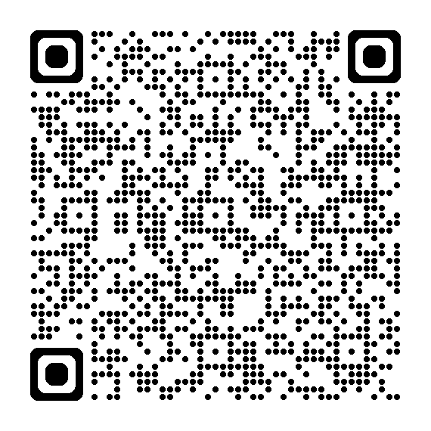
New riders expand AD126 SVUL Accumulator II
Added guarantees and estate protection began August 8, 2026
Two new riders strengthen SVUL Accumulator II for estate and legacy planning.
Extended No Lapse Guarantee Rider: Long-term death benefit guarantees through age 105 or 121
Inforce window: Eligible policies may add ENLG through September 8, 2026
Estate Protection Rider: Adds early-year death benefit protection for new policies
Availability: New business in all jurisdictions except NY and CA
Scan the QR code for details and resources on Info Central.
Notes:
New riders expand AD126 SVUL Accumulator II
Beginning August 8, 2026, AD126 SVUL Accumulator II will offer two new riders that enhance its value for estate and legacy planning. The Extended No Lapse Guarantee Rider provides long-term death benefit guarantees through age 105 or 121 and includes a limited opportunity for eligible inforce policies to add the rider through September 8. The Estate Protection Rider will also be available on new policies, providing additional death benefit protection during the first four policy years. Additional details and resources are available on Info Central.
Contact: PLAN@newyorklife.com
Info Central page: https://www.today.newyorklife.com/agencyportal/s/article/New-Extended-No-Lapse-Guarantee-Rider-Launching-on-AD126-SVUL-Accumulator-II

Slide 13

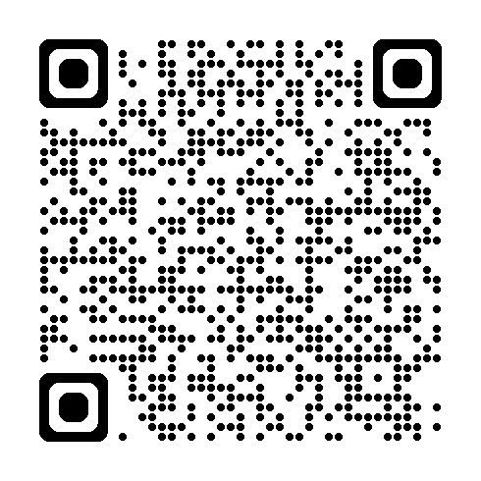
12% DCA – Offer ends this week
12%
DCA SPECIAL RATE
Dollar Cost Averaging special rate
Variable Universal Life & Market Wealth Plus
Premier and Premier Plus Variable Annuity
12% DCA SPECIAL RATE ENDS AUGUST 21
Take advantage of this limited-time opportunity before it expires.
DCA Plus client mailing reminder
Select clients received an email promoting the 12% DCA Plus rate. Review your Sales Central client list and follow up with clients who may benefit.
Scan the QR code for details on Info Central.
Notes:
Contact: PLAN@newyorklife.com
12% DCA Rate Info Central page: https://www.today.newyorklife.com/agencyportal/s/article/Limited-Time-12-DCA-Rates-for-VA-and-VUL

Slide 14


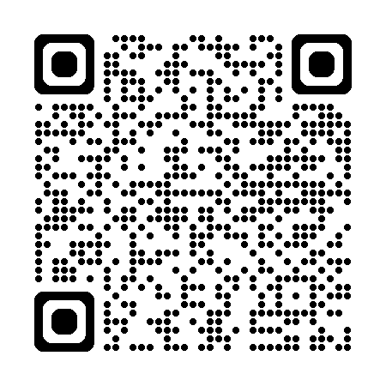
Don’t miss the next Advanced Life Sales Series webinar
Planning for the Business Owner
Date: Wednesday, August 19, 2026 Time: 3:00 p.m. – 4:00 p.m. ET*
Featured speaker
Join Brad Trevino for a practical discussion on planning opportunities for business owners:
Business succession and exit planning
Ownership transfer and inheritance equalization
Supplemental retirement income using life insurance
Gain actionable ideas to start meaningful conversations and uncover new planning opportunities with business-owner clients.
Scan the QR code to register for the Advanced Life Sales Series webinar.
Brad Trevino JD, LL.M, MBA, MS
Corporate Vice President
Senior Advanced Planning Consultant
*3:00 p.m. ET | 2:00 p.m. CT | 1:00 p.m. MT | 12:00 p.m. PT
Notes:
Don’t miss the next Advanced Life Sales Series webinar
Join us for the next installment of the Advanced Life Sales Series, featuring planning strategies and considerations for working with business owners.
Additional details and speakers will be announced soon.
Contact: PLAN@newyorklife.com
Registration link: https://nylife.zoom.us/webinar/register/WN_FF6BT7-AS4Sf9qKgXgSYvQ#/registration

Slide 15
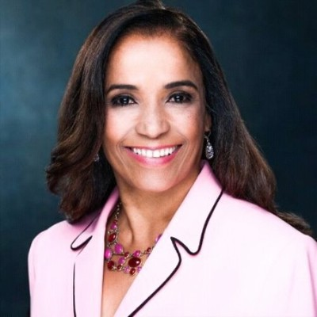
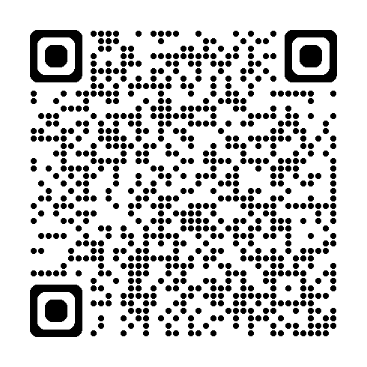
September National PLAN Webinar
Improve Your Case Rate. Write More WL Cases.
Date: Wednesday, September 2, 2026 Time: 2:00 p.m. ET*
Featured speaker
In recognition of Life Insurance Awareness Month, join John Egan and President’s Council agent Maria Jimenez, the company’s top case writer, for a practical conversation focused on improving case rate. Hear how Maria approaches Whole Life conversations, positions the value with clients, and connects the solution to their needs.
Scan the QR code to register for the September National PLAN webinar.
Maria Jimenez
President’s Council Agent
Queens GO
*2:00 p.m. ET | 1:00 p.m. CT | 12:00 p.m. MT | 11:00 a.m. PT
Notes:
September National PLAN Webinar
Date: Wednesday, September 2, 2026 Time: 2:00 p.m. ET
In recognition of Life Insurance Awareness Month, join John Egan and President’s Council agent Maria Jimenez, the company’s top case writer, for a practical conversation focused on improving case rate. Hear how Maria approaches Whole Life conversations, positions the value with clients, and connects the solution to their needs.
Contact: PLAN@newyorklife.com
Registration link: https://nylife.zoom.us/webinar/register/2417863690902/WN_uW9yHbM3RMqv7UMXimh5AA#/registration

Slide 16

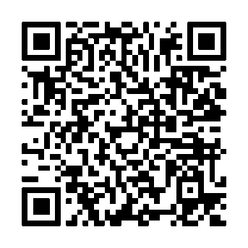
3Q Life Fundamentals Series (Final 2 sessions)
Strengthening the foundation for confident life insurance conversations
Life Insurance
7/14 | Session 1 | Term Life Overview and Key Concepts
7/21 | Session 2 | Integrating WL into Planning Guest Speaker: Allen Hensley
7/28 | Session 3 | Whole Life Product Overview & Riders
8/4 | Session 4 | Whole Life Key Sales Concepts: SLIRP, BOWL, & FIR
8/11 | Session 5 | Variable Universal Life Product Overview & Key Concepts
8/18 | Session 6 | Universal Life Product Overview & Key Concepts
8/25 | Session 7 | Universal Life Product Case Study Live Demonstration
7-part quarterly series (Tuesdays)
Educates on NYL life products
Interactive sessions with product experts
Provides ongoing education
Open to agents and managers
Register today to ensure prompt access to these highly anticipated events.
Events start at 1 pm ET* and run for 60 minutes.
*12 pm CT, 11 am MT, 10 am PT, 9 am Alaska, 7 am Hawaii
Notes:
3Q Life Fundamentals Series
The 3Q Life Fundamentals Series is a seven-session program designed to build confidence and strengthen foundational life insurance knowledge. Sessions are held every Tuesday at 1:00 PM ET and cover key product concepts, sales strategies, and practical applications across the life insurance portfolio.
Led by product experts, the series is open to agents and managers looking to expand their product expertise and enhance client conversations. Each session is 60 minutes, and registration is available through the QR code.
Contact: PLAN@newyorklife.com
Registration link: https://nylife.zoom.us/webinar/register/WN_4__InmH2QIqT5801tAJuKg

Slide 17

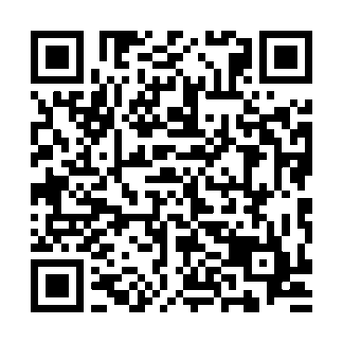
3Q 2026 Registered Rep MasterClass
Session 1 NYLIFE Securities and Mutual Funds July 14
Session 2 Variable Annuities, What You Need to Know July 21
Session 3 Positioning IndexFlex July 28
Session 4 Variable Annuity Riders August 4
Session 5 Working in the Rollover Market August 11
Session 6 Positioning VUL August 18
Session 7 Understanding IRA Opportunities August 25
Session 8 Annuity New Business and Suitability September 1
Session 9 Small Business Solutions September 8
Session 10 Morningstar: Researching Funds September 15
Strengthening the foundation
10-part quarterly series - Tuesdays at 3pm EST
Educates on NYL products
Interactive sessions with product experts
Provides ongoing education
Register today to ensure prompt access to these highly anticipated events.
Events start at 3pm EST and run 60 minutes.
Notes:
3Q 2026 Registered Rep MasterClass
Starting Tuesday July 14 at 3pm EST running for 10 weeks
Contact: PLAN@newyorklife.com
Registration link: https://nylife.zoom.us/webinar/register/WN_Wm0kOIhQTUG-ZypKnrJrVQ#/registration

Slide 18
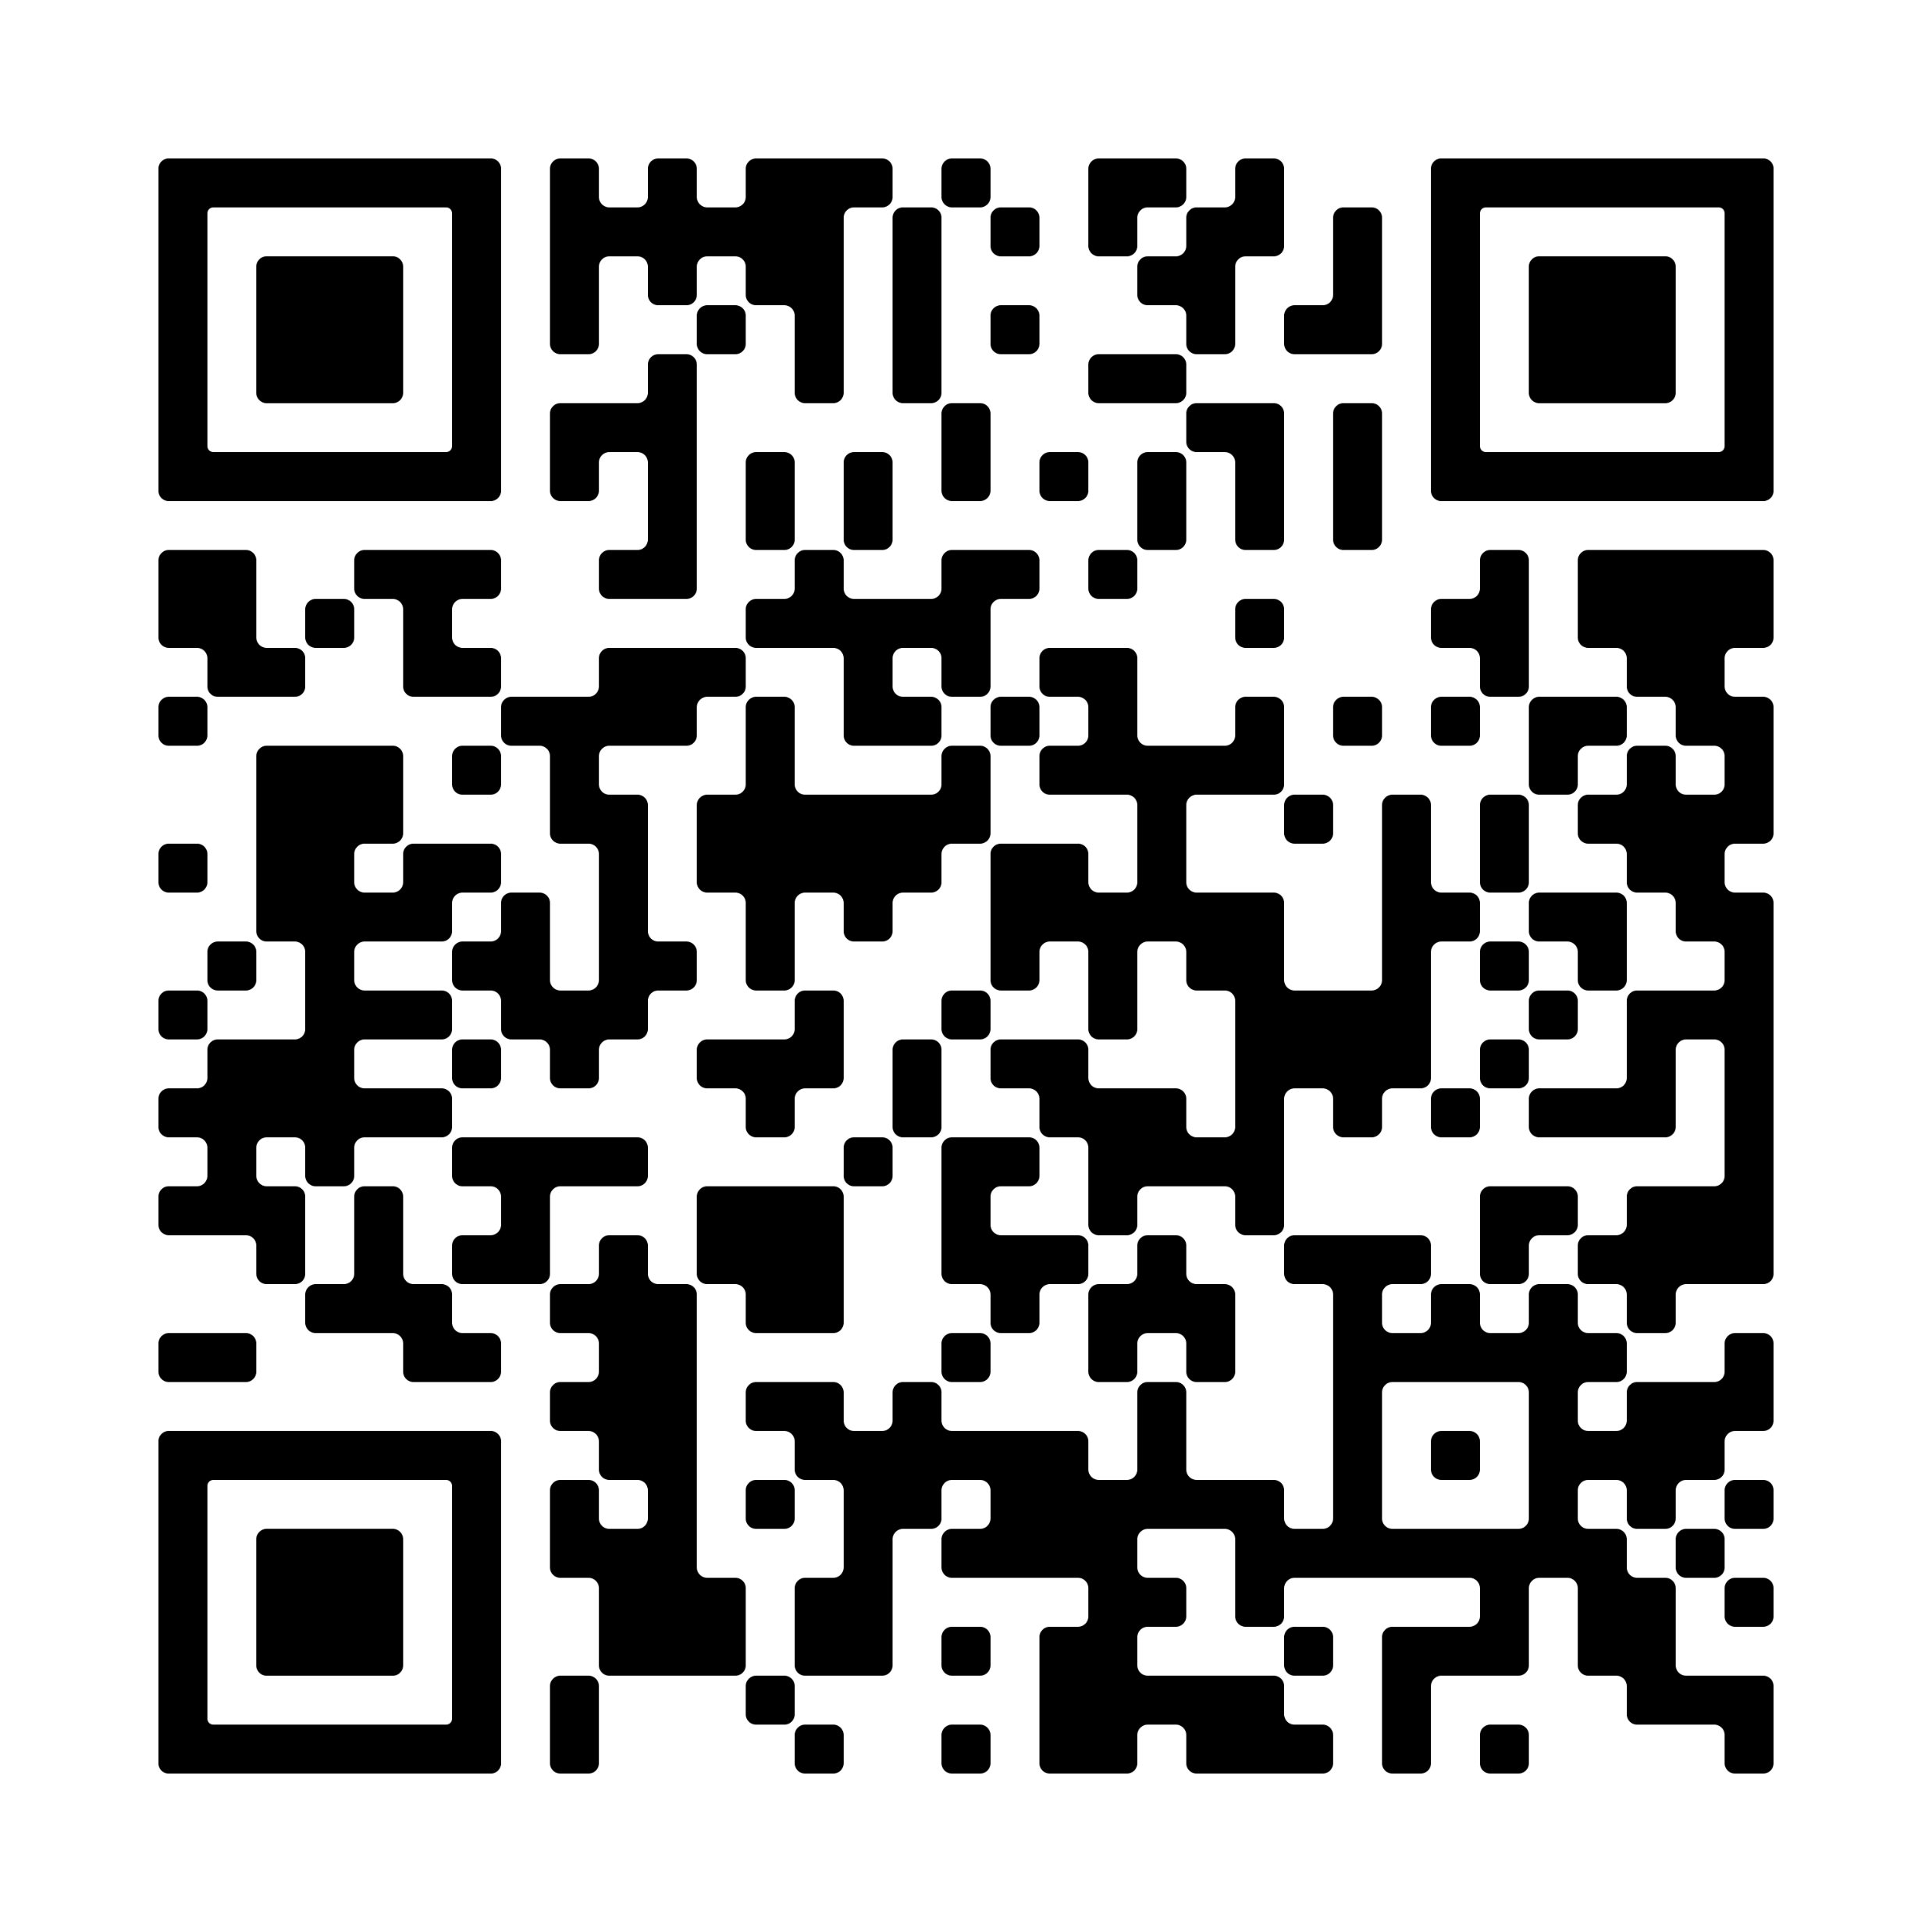
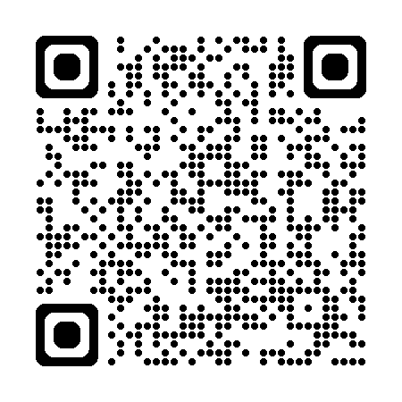
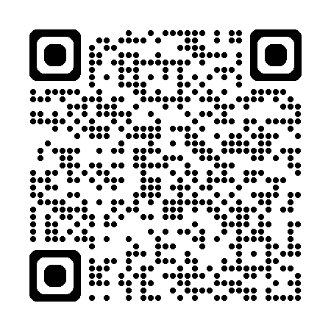
Target Markets Upcoming Webinars
AAMU Strong: Mentorship & Collaboration
Monday, August,17, 4 pm ET
Korean Market Agents Resource Lab
Monday, August,17, 4 pm ET
South Asian Market Key to Success
Monday, August,17, 4 pm ET
Learn about one of the most powerful tools to successful collaboration. New York Life now has many different forms of relationships agents can form from Mentorships to formalized Teams.
Guest:
Jenna Jernigan
Agent Collaboration and Partnership
Monthly in-language training and development hour on tools and resources followed by Q&A
Webinar designed to empower agents with actionable strategies, industry insights and opportunities to elevate their business.
Scan the QR code to register today!
Scan the QR code to register today!
Scan the QR code to register today!
Notes:
-- -- --
AAMU Strong: Mentorship & Collaboration
(for New Org, Estab and Second Line Managers)
Learn about one of the most powerful tools to successful collaboration. New York Life now has many different forms of relationships agents can form from Mentorships to formalized Teams.
Guest: Jenna Jernigan, Agent Collaboration and Partnership
Contact: africanamericanmarket@newyorklife.com Registration: https://nylife.zoom.us/meeting/register/XQiOaW_ESyiCmTwOsLKtVw
Submitted by: John Macchia
-- -- --
Korean Market Agents Resource Lab
(for New Org, Estab and Second Line Managers)
Monthly in-language training and development hour on tools and resources followed by Q&A
Contact: targetmarkets@newyorklife.com Registration: https://nylife.zoom.us/meeting/register/Xo5x6s4hShq4FiHBPSzXpw
Submitted by: John Macchia
-- -- --
South Asian Market Key to Success
(for New Org, Estab and Second Line Managers)
Webinar designed to empower agents with actionable strategies, industry insights and opportunities to elevate their business.
Contact: targetmarkets@newyorklife.com
Registration: https://nylife.zoom.us/webinar/register/WN_f3aeTgdpSBuor2kFCC1CoA
Submitted by: John Macchia

Slide 19

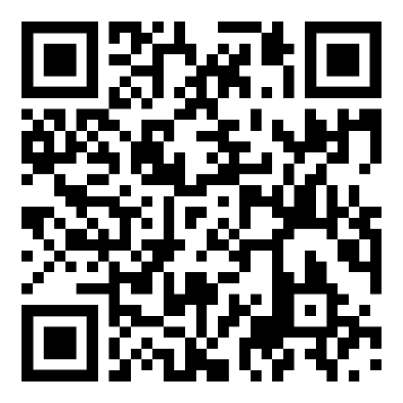
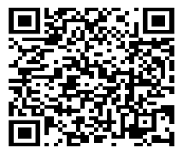
Total Morningstar
Complete Guide to Morningstar Proposals & Sales Concepts
Topics:
September 8: Morningstar Proposal Building Walkthroughs
September 15: Reading and Understanding Morningstar IPT Reports
September 22: Morningstar Research & Portfolio Concepts
September 29: Morningstar Proposal Full Use with Case Study
Host: Morningstar IPT Training Team Time: Each Session Starts at 2PM EST
Duration: 1 Hour Sessions: Choose Many or Just One
Live demo: Leverage Advanced Morningstar Features!
Live chat: Support Throughout!
One-on-one sessions
Scan to register
SMRU 9058997.1 Exp 9/30/2026 For Internal Use Only
Notes:
Hello, IPT will be doing a 4 part series on Morningstar. The first will feature a basic walkthrough and the rest of the sessions will focus around using Morningstar as a sales tool. Please email ipt@newyorklife.com for questions.
Here is the zoom link: https://nylife.zoom.us/webinar/register/WN_T41aXq9TSn6kRa619U-Vxg#/registration
One on One Sessions: https://calendly.com/d/cmvp-63d-k47/morningstar-ipt-support

Slide 20
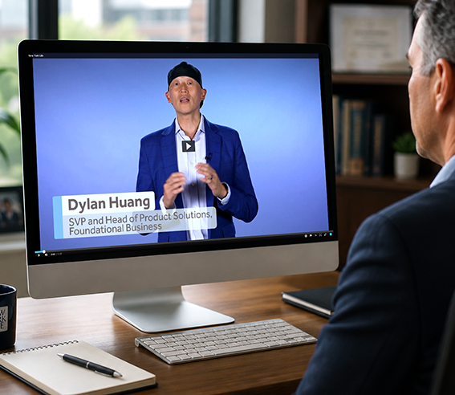
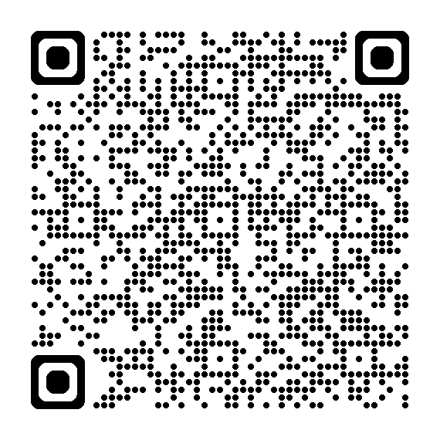
See what’s new with Asset Flex AD126
Use this new video to help your team understand the enhancements.
Key enhancements:
New indemnity cash benefit option
Reimbursement option remains available
Improved reimbursement pricing in ~85% of scenarios*
More flexibility for LTC planning conversations
New AD126 video and resources on Info Central
Scan the QR code for the Asset Flex AD126 video, program details and resources on Info Central.
*Results vary by client and policy factors.
Notes:
See what’s new with Asset Flex AD126
Asset Flex AD126 is now available with added flexibility for clients, including a new indemnity cash benefit option alongside the existing reimbursement option. Reimbursement pricing has also improved in approximately 85% of scenarios. Encourage your team to watch the new video and use the resources on Info Central to get familiar with the enhancements and support client conversations.
Contact: PLAN@newyorklife.com
Info Central Page and video: https://www.today.newyorklife.com/agencyportal/s/article/Asset-Flex-AD126-launches-with-added-benefit-option-and-improved-reimbursement-pricing

Slide 21
Estab: What’s important week of August 17

Slide 22


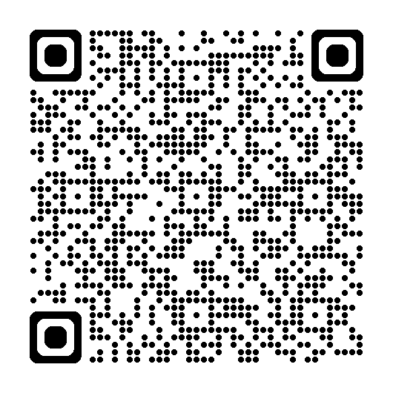
President’s Council Beachfront Boutique Experience
Council Perks!
An exclusive shopping experience for top performers
Finish top 100 on the 3Q Paid Insurance Solution premium¹ leaderboard and receive a retail credit² at the private shopping event, October 6–7. Finish in the top 10 and enjoy a premium Balinese-inspired beach hut rental on October 7.
To qualify:
Qualification period: July 1 – September 30
2026 President’s Council qualifiers
Prorata proactive by September 30
Must attend President’s Council
Scan the QR code for complete rules, requirements, qualifying products, and official incentive details.
¹ Includes Life, LTCi, and DI. Recurring base premium and riders are calculated at 100%; OPP and single premium policies are calculated at 10%. Excludes premium from Annuity and COLI/BOLI products, DIOP and Group Insurance cases and LTC in DE state.
² $300 retail credit
Notes:
President's Council Beachfront Boutique Experience – Open to 2026 President’s Council agent qualifiers
Compete with your President’s Council peers during the Third Quarter of 2026 (July 1 – September 30)
Agents who finish in the 100 on the 3Q paid insurance solution premium leaderboard will qualify to receive a retail credit to spend at a private New York Life shopping event at the President’s Council meeting on October 6 & 7.
The top 10 will also qualify for a premium chickee hut rental on October 7!
Includes Life, LTCi, and DI. Recurring base premium and riders are calculated at 100%; OPP and single premium policies are calculated at 10%
Excludes premium from Annuity and COLI/BOLI products, DIOP and Group Insurance cases and LTC in DE state.
Agents must be prorata proactive by September 30.
The experience encompasses an elevated retail shopping event with a $300 retail credit, complete with refreshments and private access to the resort's premier ladies and gentlemen’s boutiques, Sweet Waters and Cross Winds. Browse stylish women's apparel, swimwear, and accessories from brands such as Lilly Pulitzer®, lululemon®, Versace®, and Gucci®, or explore the latest men's fashion and accessories from designers including BUGATCHI®, Tommy Bahama®, Maui Jim®, Ray-Ban®, and lululemon®. Personal shoppers will also be available to help agents make the most of their experience.
The top 10 leaderboard agents will also qualify for a premium chickee hut rental on the JW Marriott’s breathtaking beach on Wednesday, October 7. This Balinese-inspired shaded retreat accommodates up to six guests and is ideally located between the beach and pool. Rental includes a queen daybed, chairs, and towel service.
Qualifying agents must attend the President’s Council Meeting to receive the retail credit and chickee hut rental.
Contact: PLAN@newyorklife.com
Info Central Page: https://www.today.newyorklife.com/agencyportal/s/article/Council-Perks-President-s-Council-Beachfront-Boutique-Experience

